Slide 1
Outline
XML Schema Overview
XML Schema Components
XML Schema Reusability & Conformance
XML Schema Applications and IDE

Slide 2
XML Schema Overview
What is XML Schema?
Why Schema?
A Simple XML Schema Example
How to Convert DTD to Schema?

Slide 3
What is XML Schema?
The origin of schema
  XML Schema documents are used to define and validate the content and structure of XML data.
  XML Schema was originally proposed by Microsoft, but became an official W3C recommendation in May 2001

Slide 4
Why Schema? (1)
Separating Information from Structure and Format
Information
Information
Structure
Format
Format
Structure
Traditional Document:
Everything is clumped together
“Fashionable” Document: A document is broken into discrete parts, which can be treated separately

Slide 5
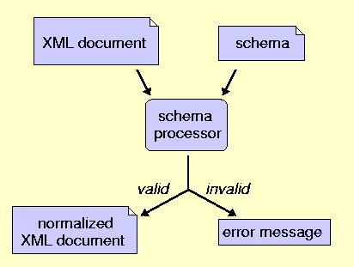
Why Schema? (2)
Schema Workflow

Slide 6
DTD versus Schema
Limitations of DTD
  No constraints on character data
  Not using XML syntax
  No support for namespace
  Very limited for reusability and extensibility
Advantages of Schema
  Syntax in XML Style
  Supporting Namespace and import/include
  More data types
  Able to create complex data type by inheritance
  Inheritance by extension or restriction
  More …

Slide 7
Problems of XML Schema
General Problem
  Several-hundred-page spec in a very technical language
Practical Limitations of expressibility
  content and attribute declarations cannot depend on attributes or element context.
Technical Problem
  The notion of “type” adds an extra layer of confusing complexity
…

Slide 8
An XML Instance Document Example
<book isbn="0836217462">
<title> Being a Dog Is a Full-Time Job</title>
<author>Charles M. Schulz</author>
<qualification> extroverted beagle </qualification>
</book>

Slide 9
The Example’s Schema
<?xml version="1.0" encoding="utf-8"?>
<xs:schema xmlns:xs="http://www.w3.org/2001/XMLSchema">
<xs:element name="book">
<xs:complexType>
<xs:sequence>
<xs:element name="title" type="xs:string"/>
<xs:element name="author" type="xs:string"/>
<xs:element name=“qualification“ type=“xs:string”/>
</xs:sequence>
</xs:complexType>
</xs:element>
</xs:schema>
book.xsd

Slide 10
Outline
XML Schema Overview
XML Schema Components
XML Schema Reusability & Conformance
XML Schema Applications and IDE

Slide 11
Outline
XML Schema Overview
XML Schema Components
XML Schema Reusability & Conformance
XML Schema Applications and IDE

Slide 12
XML Schema Components
Abstract Data Model
Simple and Complex Type Definitions
Declarations
Relationship among Schema Components
Notes:
So far, we have talked about why we need schema and what is schema. Now, I’ll present how to compose XML schemas based on W3C specification. The sub-topics include the Abstract data model, type definitions and declarations. Also I will try to illustrate the relationships among the components of the abstract data model.

Slide 13
XML Abstract Data Model
The XML Abstract Data Model
  composes of Schema Components.
  is used to describe XML Schemas.
Schema Component
  is the generic term for the building blocks that compose the abstract data model of the schema.
Notes:
W3C defined an abstract data model to describe XML schemas, and it is composed of schema components. we can write XML schemas using the components as building blocks.

Slide 14
13 Kinds of Schema Components
Annotations
Model groups
Particles
Wildcards
Attribute Uses
Simple type definitions
Complex type definitions
Attribute declarations
Element declarations
Attribute group definitions
Identity-constraint definitions
Model group definitions
Notation declarations
Notes:
There are 13 kinds of components defined in the model. They are classified into three groups, primary, secondary, and helper group. I will present how to compose schemas based on the components.

Slide 15
XML document & XML Schema
XML Document
(.xml)
XML Schema
(.xsd)
Declaration
Type Definition
Information
Items
…
Elements
Attributes
Notes:
All items in XML documents must conform to the declaration in schemas. Or we can say they must be validated according to the declarations in schemas. The most important declarations are Element and attribute declarations. So basically, we need to declare elements and attributes in schemas. To declare them, we need to define their types, just like to define classes in OOP. So basically, there are two kinds of activity when writing schemas, declaration and definition.

Slide 16
Declaration & Definition
Declaration Components
  are associated by (qualified) names to information items being validated.
  It is like declaring objects in OOP.
Definition Components
  define internal schema components that can be used in other schema components.
  Type definition is like defining classes in OOP.
Notes:
Declaration is to associate a name with a type definition. It is like declaring objects in OOP, while definition is to define internal schema components used in other components. Type definition is like defining class in OOP.

Slide 17
Examples
<book isbn="0836217462">
<title>
Being a Dog Is a Full-Time Job
</title>
……
Declaration
</book>
<xs:element name="book">
<xs:complexType>
<xs:sequence>
<xs:element name="title" type="xs:string"/>
    … …
</xs:sequence>
<xs:attribute name="isbn" type="xs:string"/>
</xs:complexType>
</xs:element>
Type Definition
<xs:element name="book" type="bookType"/>
<xs:complexType name="bookType">
<xs:sequence>
<xs:element name="title" type="nameType"/>
  … …
</xs:sequence>
<xs:attribute name="isbn" type="isbnType" use="required"/>
</xs:complexType>
Notes:
Here are examples for declaration and definition. In the first block, we declare an element named “book”, while in an instance XML document, we can fill out values. In the second block, we define a complex data type named “bookType”, and then we can declare an element,book, somewhere, based on the type.

Slide 18
Type Definitions
Why Type Definitions?
Simple Type Definition VS. Complex Type Definition
Simple Type
Definition
Attributes & Elements without element children
Complex Type
Definition
Elements
Notes:
By type definition, we can do type checking using applications, also we can reuse our type definitions. There two kinds of type definition, simple and complex. The former can be used to declare attributes and elements without element children, while the latter can only be used to declare elements.

Slide 19
Simple Type Definition
Simple Type Definition can be:
  a restriction of some other simple type;
  a list or union of simple type definition;or
  a built-in primitive datatypes.
Example
<xs:simpleType name="farenheitWaterTemp">
<xs:restriction base="xs:number">
<xs:fractionDigits value="2"/>
<xs:minExclusive value="0.00"/>
<xs:maxExclusive value="100.00"/>
</xs:restriction>
</xs:simpleType>
Notes:
Simple type can be a restriction of other simple type definition, a list or union of other simple type definition, or built-in primitive data types. Here is an example of simple type definition. We define a simple type to describe water temperature. We define it by restricting a base type number, which is a built-in type. To restrict the base type ,we use the restriction element, we can specify the base type and other restrictions, such as minimum and maximum values.

Slide 20
Complex Type Definition(1)
Inheritance
  Restriction: We restrict base types definitions.
  Extension: We add something new.
Composition
  Group model
Notes:
As in OOP, there are two kinds of mechanism we can define complex type, in inherit ion and composition. As for inheritance, we can restrict or extend a base type.
Composition is achieved by using the group model component in the abstract model.

Slide 21
Complex Type Definition(2)
Inheritance
  Each complex type definition is either
  a restriction of a complex type definition
  an extension of a simple or complex type definition
  a restriction of the ur-type definition.
Example
<xs:complexType name="personName">
<xs:complexType name="extendedName">
<xs:sequence>
<xs:complexContent>
<xs:extension base="personName">
<xs:element name="title" minOccurs="0"/>
<xs:sequence>
  … …
<xs:element name="generation"
minOccurs="0"/>
</xs:sequence>
</xs:sequence>
</xs:complexType>
</xs:extension>
</xs:complexContent>
</xs:complexType>
Notes:
Specifically, we can define a complex type by restricting another complex type, extending a simplex or complex type definition, or restricting a ur-type definition. A ur-type is a special type definition that can be as both simple and complex definition. Because we have seen an example of restriction in simple type definition. Here we give only an example of extension. Based on a complex type called personName, we define a new complex type by using extension element. Here we add a new element called generation.

Slide 22
Complex Type Definition(3)
Composition
  Model Group is composed of
  Compositor (sequence |choice| all )
  Particles, which can be
        Element Declaration
        Wildcard
        Model Group
Notes:
Besides inheritance, we can also define a new complex type by composition. The Model Group component in the abstract data model is for this use. A model group is composed of compositor and partials. While particle is a general term for element declaration.wildcard, or model group. So, we can seen model group is defined recursively. Wildcard is a special kind of particle dependent on their namespace name, independently of their local names.

Slide 23
Complex Type Definition(4)
Model Group Examples
<xs:all>
<xs:element ref="cats"/>
<xs:element ref="dogs"/>
</xs:all>
<xs:sequence>
<xs:choice>
<xs:element ref="left"/>
<xs:element ref="right"/>
</xs:choice>
<xs:element ref="landmark"/>
</xs:sequence>
Notes:
In model group, there are three compositors. All means each particles between the two tags appear at most once, but in any order. Sequence means all particles muse appear in the specified order. While choice, only one of the particle can appear in an instance document.

Slide 24
Complex Type Definition(5)
Reusable Fragments of Type Definition
  Model group definition
  Attribute group definition
<xs:group name="mainBookElements">
<xs:sequence>
<xs:element name="title" type="nameType"/>
<xs:element name="author" type="nameType"/>
</xs:sequence>
</xs:group>
<xs:complexType name="bookType">
<xs:sequence>
<xs:group ref="mainBookElements"/>
  … …
</xs:sequence>
<xs:attributeGroup ref="bookAttributes"/>
</xs:complexType>
Notes:
Besides inheritance, we have other way to reuse type definition. The two component Model group definition and Attribute group definition are for this use. Like this, we define a model group type called mainBookElement, and then use them in other type definitions.

Slide 25
Declarations(1)
Element Declaration
Attribute Declaration
  Attribute uses
Notation Declaration
  Notation declarations reconstruct XML 1.0 NOTATION declarations.
Notes:
There are three kinds of declaration. Element, attribute and notation. All of them are components in the abstract data model. In attribute declaration, we may use Attribute uses to indicate whether the attribute is required, whether it valued is fixed and its default value. Please note Attribute use is an auxiliary component in the abstract data model. By notation declaration, we can redefine the notations I XML 1.0.

Slide 26
Declarations(2)
Examples
<xs:element name="PurchaseOrder" type="PurchaseOrderType"/>
<xs:element name="gift">
<xs:complexType>
<xs:sequence>
<xs:element name="birthday" type="xs:date"/>
<xs:element ref="PurchaseOrder"/>
</xs:sequence>
</xs:complexType>
</xs:element>
<xs:attribute name="age" type="xs:positiveInteger" use="required"/>
<xs:notation name="jpeg" public="image/jpeg" system="viewer.exe">
Notes:
Here are some declaration examples.
In the first fragment, we declare an element PurchaseOrder based on type definition PurchaseOrderType
In the second example, we declare an element gift based on an anonymous type definition.
In the third block, we declare an attribute based on a built-in data type, pls note that the the keyword USE belongs to the Attribute use component. It is to specify the use of the attribute is required.
In the last example,we define a notation, “jpeg” .

Slide 27
Annotations
Annotations provide for human- and machine-targeted documentations of schema components.
They are meta-data.
<xs:simpleType fn:note="special">
<xs:annotation>
<xs:documentation>A type for experts only</xs:documentation>
<xs:appinfo>
<fn:specialHandling>checkForPrimes</fn:specialHandling>
</xs:appinfo>
</xs:annotation>
Notes:
Annotation is also a component of the abstract data model. It can applied to any other component to provide meta-data.
In the example, we put both human and machine readable annotation in a simple type definition.

Slide 28
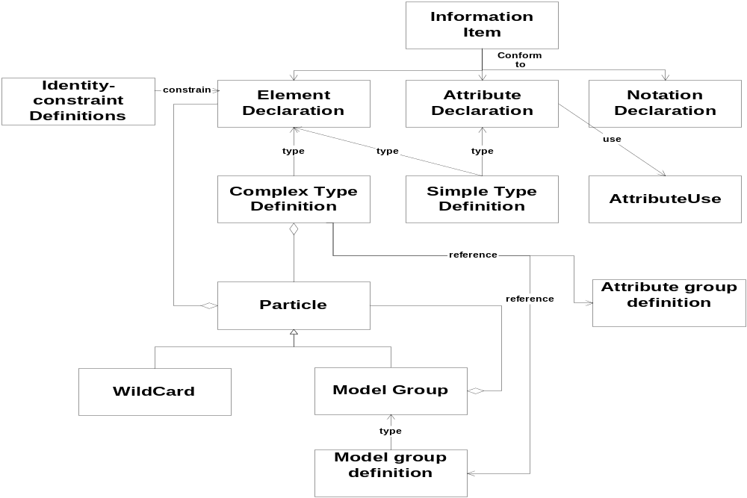
Relationships among Schema Components
Notes:
Finally, I try to illustrate the relationships among the 13 kinds of complements in a UML style. This is not a format diagram. It only helps use understand the relationships.
All information items in instance XML documents must conform to declarations in Schema. They are element, attribute, and notation declaration.
When we declare elements ,we may need the identity-constrain component to specify uniqueness and key.
When we declare attributes, we may need attributeUSE component to specify more properties.
Element and attribute declarations must based on simple or complex type definition.
Complex type definition can be composed particles. While particles can be element declaration, wildcard, or model group.
Attribute group definition and Model group definition are reusable fragments.
I’ve introduced the W3C abstract data model for composing XML schema. Next, my partner will present schema reusability and conformance.

Slide 29
Outline
XML Schema Overview
XML Schema Components
XML Schema Reusability & Conformance
XML Schema Applications and IDE

Slide 30
XML Schema
Reusability and Conformance
XML Schema Reusability
XML Schema Conformance

Slide 31
Building Reusable XML Schema
Two mechanisms
  Including and Redefining existing XML Schemas components in an XML Schema definition
  Extending or Restricting existing data types in an XML Schema definition

Slide 32
Building Reusable XML Schema- (1)
xs:include
  Similar to a copy and paste of the included schema
  The calling schema doesn't allow to override the definitions of the included schema.
xs:redefine
  Similar to xs:include
  except that it lets you redefine declarations from the included schema.
<xs:schema …>
…
<xs:redefine schemaLocation=“chaper12.xsd">
<xs:simpleType name=“title">
<xs:restriction base="xs:string">
<xs:maxLength value="40"/>
</xs:restriction>
</xs:simpleType>
</xs:redefine>
…
</xs:schema>
<xs:schema …>
…
<xs:include schemaLocation=“address.xsd"/>
<xs:include schemaLocation=“items.xsd"/>
…
</xs:schema>
purchaseOrder.xsd
chapter18.xsd

Slide 33
Building Reusable XML Schema-(2)
Group head and Group members
  Similar to Object-oriented design
  Referencing a common element (called head ) using substitutionGroup attribute
  The head element is global and abstract. All the element within a substitution group need to have a type
    the same type as head or
    a derivation from it

Slide 34
<xsd:schema xmlns:xsd="http://www.w3.org/2001/XMLSchema" >
</xsd:schema>
<xsd:element name="root">
<xsd:complexType>
<xsd:sequence>
<xsd:element ref=“abstractInt"/>
</xsd:sequence>
</xsd:complexType>
</xsd:element>
<xsd:element name=“abstractInt" type=“decimal" abstract="true"/>
<xsd:simpleType name=“decimal">
<xsd:restriction base="xsd:integer">
<xsd:minInclusive value="1"/>
<xsd:maxInclusive value="9"/>
</xsd:restriction>
</xsd:simpleType>
</xsd:element>
<xsd:element name="odd" substitutionGroup=“abstractInt">
<xsd:simpleType>
<xsd:restriction base=“decimal">
<xsd:enumeration value="1"/>
<xsd:enumeration value="3"/>
<xsd:enumeration value="5"/>
<xsd:enumeration value="7"/>
<xsd:enumeration value="9"/>
</xsd:restriction>
</xsd:simpleType>
</xsd:element>
Some invalid XML fragments:
1. <myAbstract>2</myAbstract>
2. <odd>2</odd>

Slide 35
Prohibit XML Schema Derivations
The final attribute
  Can be used in
    xs:complexType
    xs:simpleType
    xs:element
  Can take values of
    restriction
    extension
    #all (any derivation)
The fixed attribute
  Can only be used in xs:simpleType
  When it is set to true, it cannot be further modified
<xs:simpleType name=“fixedString">
<xs:restriction base="xs:string">
<xs:maxLength value="32" fixed="true"/>
</xs:restriction>
</xs:simpleType>
<xs:complexType name="characterType" final="#all">
<xs:sequence>
<xs:element name="name" type="nameType"/>
<xs:element name=“age" type=“ageType"/>
<xs:element name="qualification" type="descType"/>
</xs:sequence>
</xs:complexType>

Slide 36
What is XML Schema Conformance?
Quoted from W3C XML Schema Structure:
  Any instance XML document may be processed against any schema to verify whether the rules specified in the schema are honored in the instance or not.
However, the author of an instance XML document may claim to conform to a particular schema by using schemaLocation attribute

Slide 37
Conformance Checking for XML Instance Document
Check the root element has the right contents
Check each sub-element conforms to its description in a schema
And so on, until the entire document is verified.

Slide 38
Conformance Checking for an XML Element
Locate the declaration for this element in the XML schema
Examine the type of the element
Check the immediate attributes and contents of this element
Compare these values against the attributes and contents permitted by the element's type

Slide 39
Conformance Example: note.xml and note.xsd
<?xml version="1.0"? >
<note timestamp=“2002-12-20”>
<to>Dove</to>
<from>Jani</from>
<heading>Reminder</heading>
<body>Don't forget me this weekend!</body>
</note>
<?xml version="1.0"?>
<xs:schema xmlns:xs="http://www.w3.org/2001/XMLSchema" >
<xs:element name="note">
<xs:complexType>
<xs:sequence>
<xs:element name="to" type="xs:string"/>
<xs:element name="from" type="xs:string"/>
<xs:element name="heading" type="xs:string"/>
<xs:element name="body" type="xs:string"/>
</xs:sequence>
<xs:attribute name=“timestamp” type=“xs:date” />
</xs:complexType>
</xs:element>
</xs:schema>

Slide 40
XML Parsers
Every XML application is based on a parser
Two types of XML documents:
  Well-formed:if it obeys the syntax of XML
  Valid:if it conforms to a proper definition of legal structure and elements of an XML document
Two types of XML Parsers:
  Non-validating
  Validating
Notes:
Non-validating XML parser ensures an XML document meets the general rules of XML (e.g. non-empty tags must be properly nested, each non-empty start tag must correspond to an end tag.
Besides enforcing the syntactic rules, validating XML parser does more complicated work to ensure an instance XML document obeys the structure and format defined in the schema special for this instance document.

Slide 41
Two Ways of Interfacing XML Documents with XML Applications
Object-based: DOM (Document Object Model)
  Specified by W3C
  The parser loads the XML doc into computer memory and builds a tree of objects for all elements & attributes
Event-based: SAX (Simple API for XML)
  Originally a Java-only API.
  Developed by XML-DEV mailing list community
  No tree is built
  The parser reads the file and triggers events as it finds elements/attribute/text in the XML doc
Notes:
DOM (Document Object Model) is a platform- and language-neutral interface that will allow programs and scripts to dynamically access and update the content, structure and style of documents –W3C. The parser The parser loads the xml document into computer's memory and explicitly builds a tree of objects that contains all the elements in the XML documents.
SAX. originally a Java-only API. SAX was the first widely adopted API for XML in Java, and is a “de facto” standard. The current version is SAX 2.0.1, and there are versions for several programming language environments other than Java. The parser does not explicitly build a tree of objects. Instead, it reads the file and generates events as it finds elements, attributes, or text in the file.

Slide 42
Available XML Schema-supported Parsers
Apache® Xerces 2 Java/C++ free
  Validating/Non-validating
  DOM and SAX
Microsoft® XML Parser 4.0 free
  DOM and SAX
TIBCO® XML Validate commercial
  SAX-based implementation
  Suitable in a streaming runtime environment
SourceForge.net® JBind 1.0 free
  A data binding framework linking Java and XML
  Its Schema Compiler generates Java classes/interfaces for types contained in XML Schema.
  The runtime environment is used to read/write XML documents for validation, accessing and manipulating XML data
And many many more…
Notes:
JBIND: The framework consists of a schema compiler for generating Java sources and a runtime environment. The runtime environment is used for unmarshalling (reading) and marshalling (writing) XML documents, for validation, and for accessing and manipulating XML data.
TIBCO XMLValidate : is an enterprise-grade solution for validating streaming XML documents or messages against an XML Schema or DTD. This SAX-based implementation for run-time validation provides organizations with the core component in developing high bandwidth, XML-based processing. Its event-driven API makes XMLValidate an ideal candidate for industry-grade processing in a run-time environment, such as the financial community, which must reliably process between 10-20 million transactions a day.

Slide 43
Outline
XML Schema Overview
XML Schema---A Case Study
XML Schema Components
XML Schema Reusability & Conformance
XML Schema Applications and IDE

Slide 44
Remind Schema features
Object-Oriented Features
  Distinction between types and instances. Schema type definitions are independent of instance declarations.
  Inheritance
Relational information Features
  Like tree structure; having parents and children
  Strongly-typed: strong typing available in the specification.

Slide 45
What is XML Software Development process? -(1)
Begin with developing content model using XML Schema or DTD
2. Edit and validate XML documents according to the content model
3. Finally, the XML document is ready to be used or processed by an XML enabled framework

Slide 46
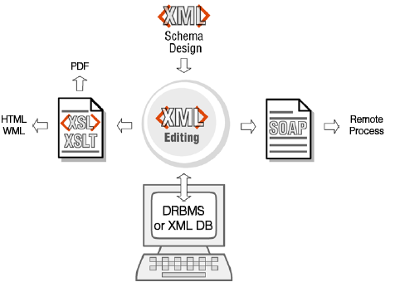
What is XML Software Development process? -(2)
The xml software development process

Slide 47
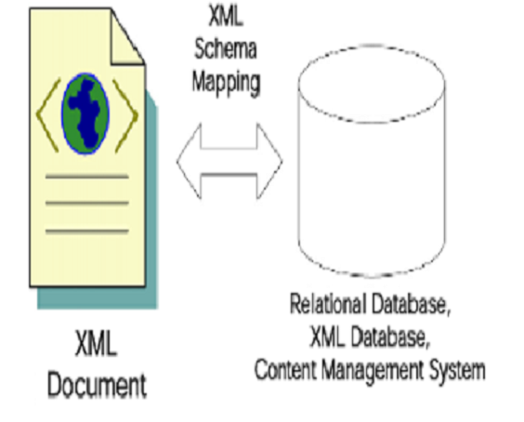
Xml schema enable translations from XML documents to databases.
Notes:
XML Schema technologies are also used to bridge the gap between databases and software objects as illustrated below in figure . XML Schema is object-oriented in nature and allows for easy mapping between XML documents and objects written in any object-oriented programming language. XML Schema is strongly-typed, and its tree structure is ideal for preserving relationship information; this makes XML Schema a requirement for mapping of XML documents to any underlying data store.

Slide 48
XML Integrated Development Environments (IDE) -1
Microsoft Visual studio
.NET
XML IDE
Data base
Programming
WEB DEVELOPMENT TOOLS
Java programming tools
XML IDE provides comprehensive XML development support and complements other software development tools
Notes:
XML Integrated Development Environments (IDE)
An XML IDE must provide development support for critical XML technologies: XML Schemas & DTD’s, XSL/XSLT, SOAP & Web services, Database Integration, as well as XML editing & validation. An XML IDE is not meant to be a replacement for an existing classic software programming IDE, web-development tool, or database programming/administration tool, but rather, the XML IDE complements and enhances any developer tool, by providing the comprehensive support for XML development for any potential application. An XML IDE must also provide tools and features to help cross the boundary from a pure XML technology to a particular language binding, server run-time environment, or database. Figure 5 below illustrates how an XML IDE complements existing software development tools.

Slide 49
XML Integrated Development Environments (IDE)-2
For example, XML Spy and Cape Clear Studio are both full XML IDEs.
Notes:
Although it's certainly possible to create a schema by hand in a simple text editor (and I'm speaking from experience here), doing so can be a maddening experience. Better to use one of the several XML tools that have cropped up recently that offer graphical systems of creating XML Schemas.
: like Microsoft visual c++, given a visual drag-and-drop interface, simply highlight content from an existing HTML file and drag it across the screen and place it in a page content model. The resulting XML Schema/DTD, XSLT stylesheet, and XML content files are all auto-generated.
an XML Schema validating parser can automatically highlights any errors on the screen as the user is typing, and also provides error messages. Document validation is done on the client side, prior to posing the document back to a server, simplifying server-side validation scripts.

Slide 50
Summary
XML Schema Overview
XML Schema---A Case Study
XML Schema Components
XML Schema Reusability & Conformance
XML Schema Applications and IDE

